Slide 1

Disease Mortality Prediction: ‘Hepatitis B
Sakshi Yadav - 711
Anushka Tawde - 748

Slide 2

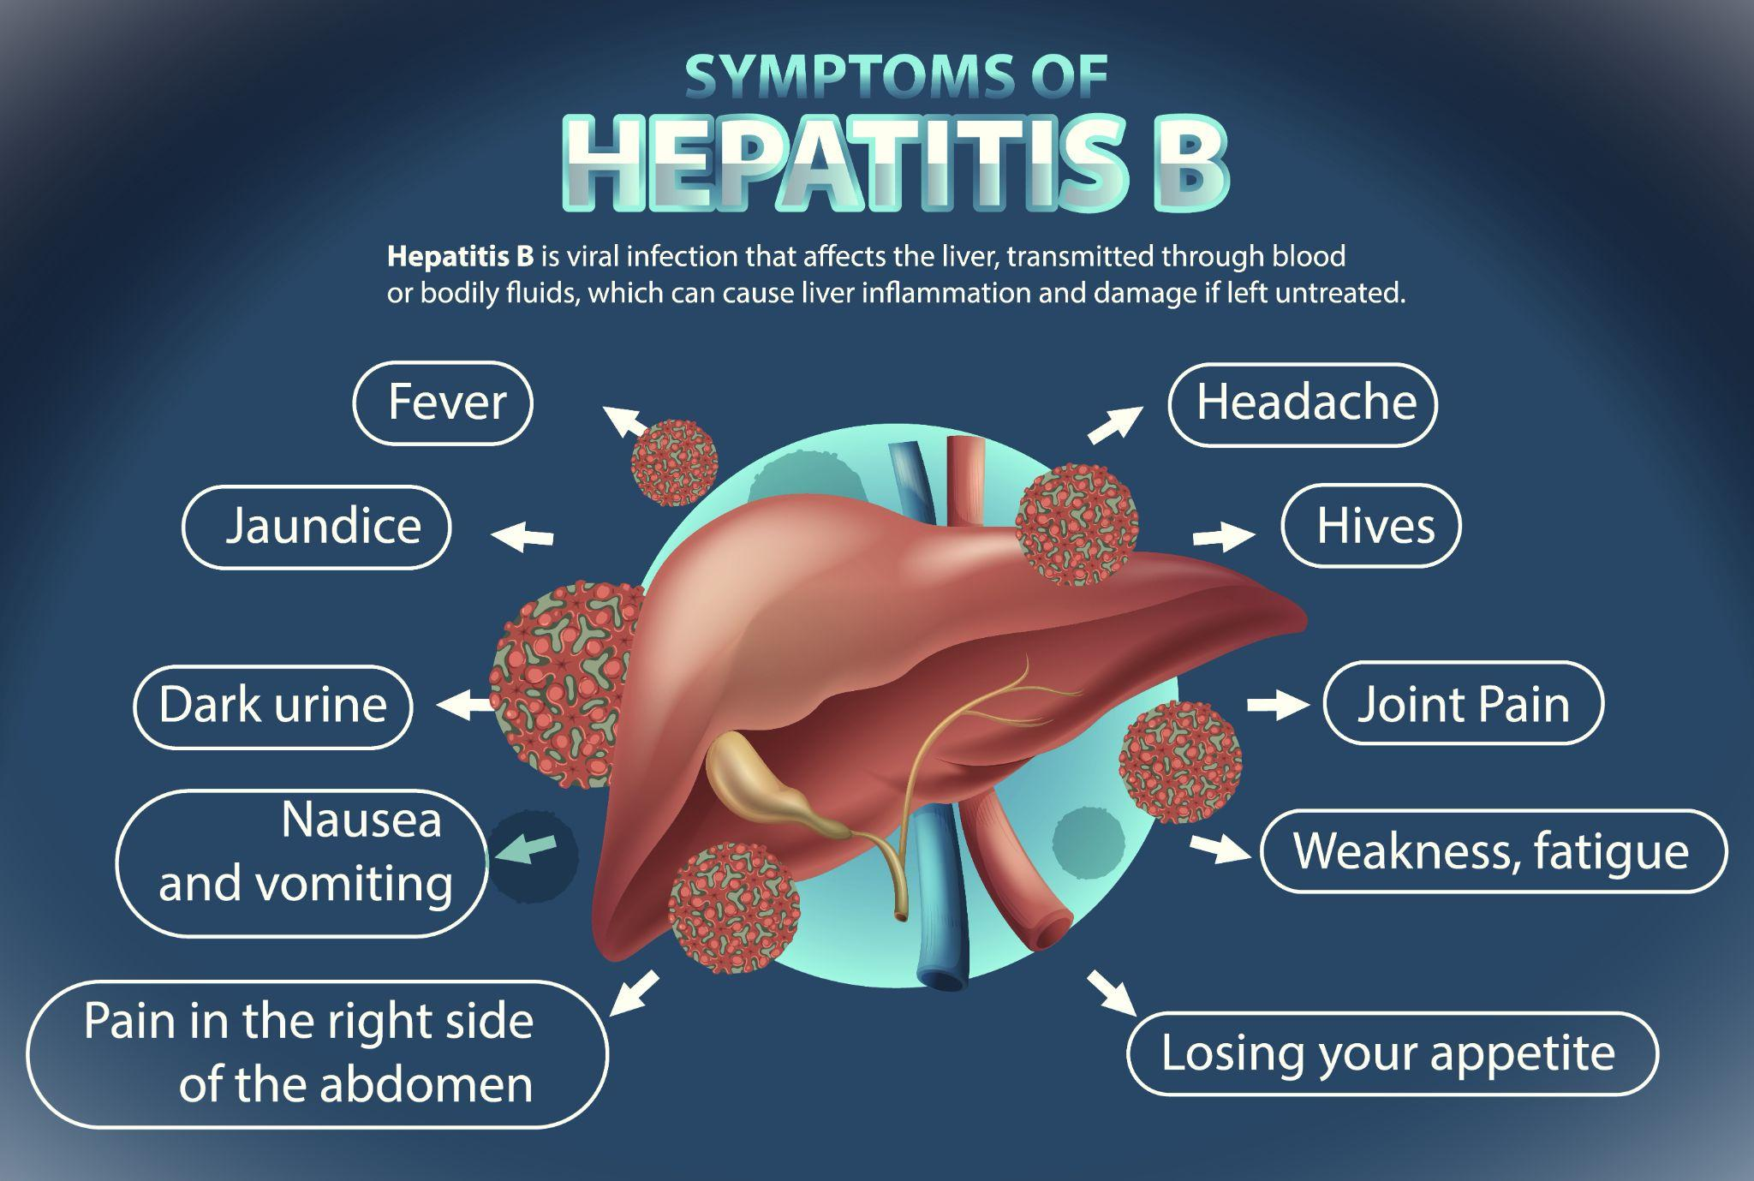
Disease Mortality Prediction: ‘Hepatitis B

Slide 3
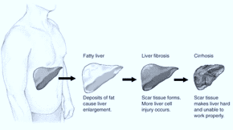
Introduction
> Hepatitis B is a viral infection that attacks the liver and can cause both acute and chronic disease Hepatitis B can range from a mild illness, lasting a few weeks, to a serious, life-long (chronic) condition.
> Hepatitis B is primarily spread when blood, semen, or certain other body fluids – even in microscopic amounts – from a person infected with the hepatitis B virus enters the body of someone who is not infected.
> Acute hepatitis B is a short-term illness that occurs within the first 6 months after someone is exposed to the hepatitis B virus. Some people with acute hepatitis B have no symptoms at all or only mild illness. For others, acute hepatitis B causes a more severe illness that requires hospitalization. The hepatitis B virus can also be transmitted by :-
1) Birth to an infected pregnant person.
2) Sex with an infected person.
3) Sharing personal items such as toothbrushes or razors, but is less common.
4) Poor infection control in health care facilities.
5) Direct contact with the blood or open sores of a person who has hepatitis B, etc.

Slide 4
OBJECTive
The main objectives of our project is :
“To predict if a patient will live or die based on the parameters using Machine Learning.”
Parameters:
Class, AGE, SEX, STEROID, ANTIVIRALS, FATIGUE, MALAISE, ANOREXIA , LIVER BIG, LIVER FIRM, SPLEEN PALPABLE, SPIDERS, ASCITES, VARICES, BILIRUBIN, ALK PHOSPHATASE, SGOT, ALBUMIN, PROTIME, HISTOLOGY

Slide 5
dataset
(rows, columns) = (155, 20)
1. Class: DIE, LIVE 2. AGE: 10, 20, 30, 40, 50, 60, 70, 80
3. SEX: male, female 4. STEROID: no, yes
5. ANTIVIRALS: no, yes 6. FATIGUE: no, yes
7. MALAISE: no, yes 8. ANOREXIA: no, yes
9. LIVER BIG: no, yes 10. LIVER FIRM: no, yes
11. SPLEEN PALPABLE: no, yes 12. SPIDERS: no, yes
13. ASCITES: no, yes 14. VARICES: no, yes
15. BILIRUBIN: 0.39, 0.80, 1.20, 2.00 16. ALK PHOSPHATE: 33, 80, 120, 160, 200, 250
17. SGOT: 13, 100, 200, 300, 400, 500, 18. ALBUMIN: 2.1, 3.0, 3.8, 4.5, 5.0, 6.0
19. PROTIME: 10, 20, 30, 40, 50, 60, 20. HISTOLOGY: no, yes

Slide 6
methodology
Data Preparation: It is the process of transforming raw data so that data scientists and analysts can run it through machine learning algorithms to uncover insights or make predictions.
EDA: Exploratory data analysis (EDA) is used by data scientists to analyze and investigate data sets and summarize their main characteristics, often employing data visualization methods.
Feature Selection: The method of reducing the input variable to your model by using only relevant data and getting rid of noise in data. It is the process of automatically choosing relevant features for your machine learning model based on the type of problem you are trying to solve
Model Building: Building a model in machine learning is creating a mathematical representation by generalizing and learning from training data. Then, the built machine learning model is applied to new data to make predictions and obtain results.
Interpret Model: It is used to find out ways to understand model decision making policies better. This is to enable fairness, accountability and transparency which will give humans enough confidence to use these models in real-world problems which have a lot of impact on business and society.
Deployment: Model deployment is the process of implementing a fully functioning machine learning model into production where it can make predictions based on data.

Slide 7
Model building
Supervised Learning Model: Supervised learning is the type of machine learning in which machines are trained using well "labeled" training data, and on the basis of that data, machines predict the output. The labeled data means some input data is already tagged with the correct output.
Classification model: A classification model tries to draw some conclusion from the input values given for training. It will predict the class labels/categories for the new data
1) K-Nearest Neighbors: Neighbors based classification is a type of lazy learning as it does not attempt to construct a general internal model, but simply stores instances of the training data.
2) Decision Tree: given a data of attributes together with its classes, a decision tree produces a sequence of rules that can be used to classify the data.
3) Logistic Regression: Logistic regression is a machine learning algorithm for classification. In this algorithm, the probabilities describing the possible outcomes of a single trial are modeled using a logistic function

Slide 8

deployment
Streamlit is a free and open-source framework to rapidly build and share beautiful machine learning and data science web apps. It is a Python-based library specifically designed for machine learning engineers. Data scientists or machine learning engineers are not web developers and they're not interested in spending weeks learning to use these frameworks to build web apps. Instead, they want a tool that is easier to learn and to use, as long as it can display data and collect needed parameters for modeling. Streamlit allows you to create a stunning-looking application with only a few lines of code.

Slide 9
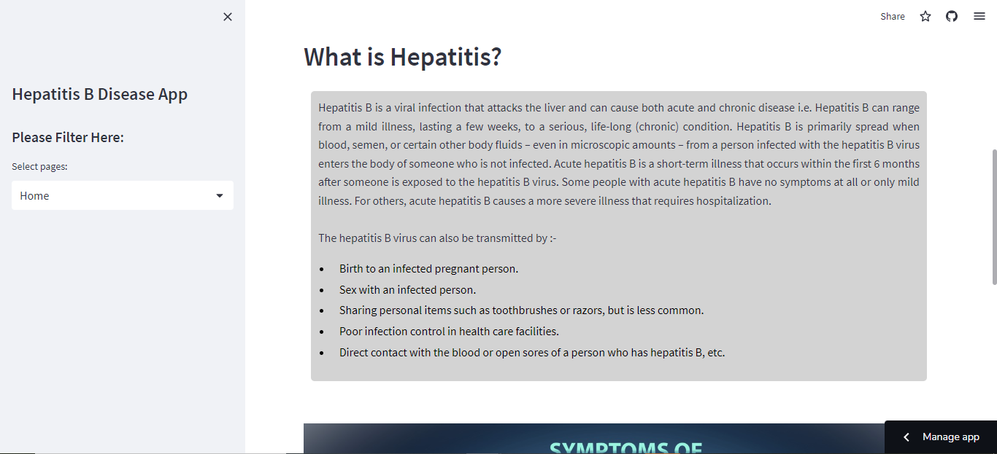
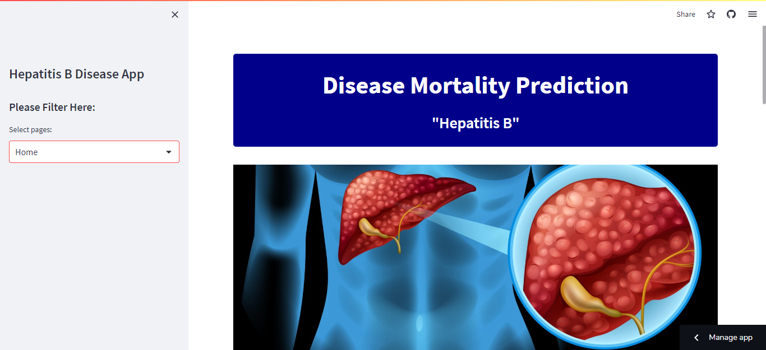
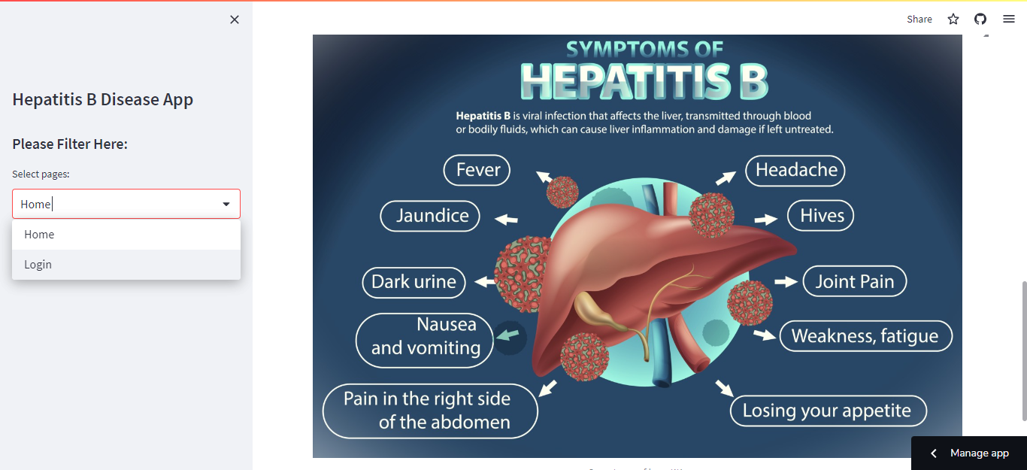
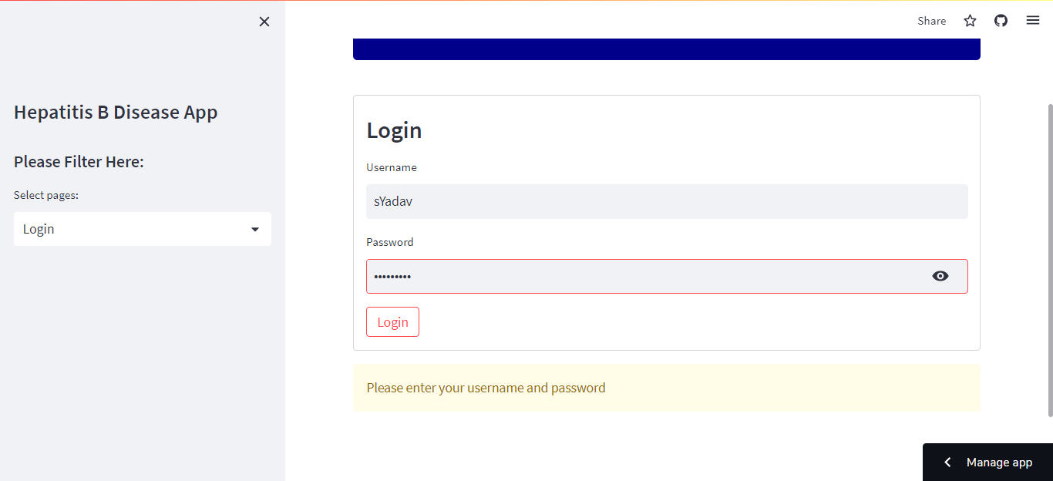
Output images

Slide 10
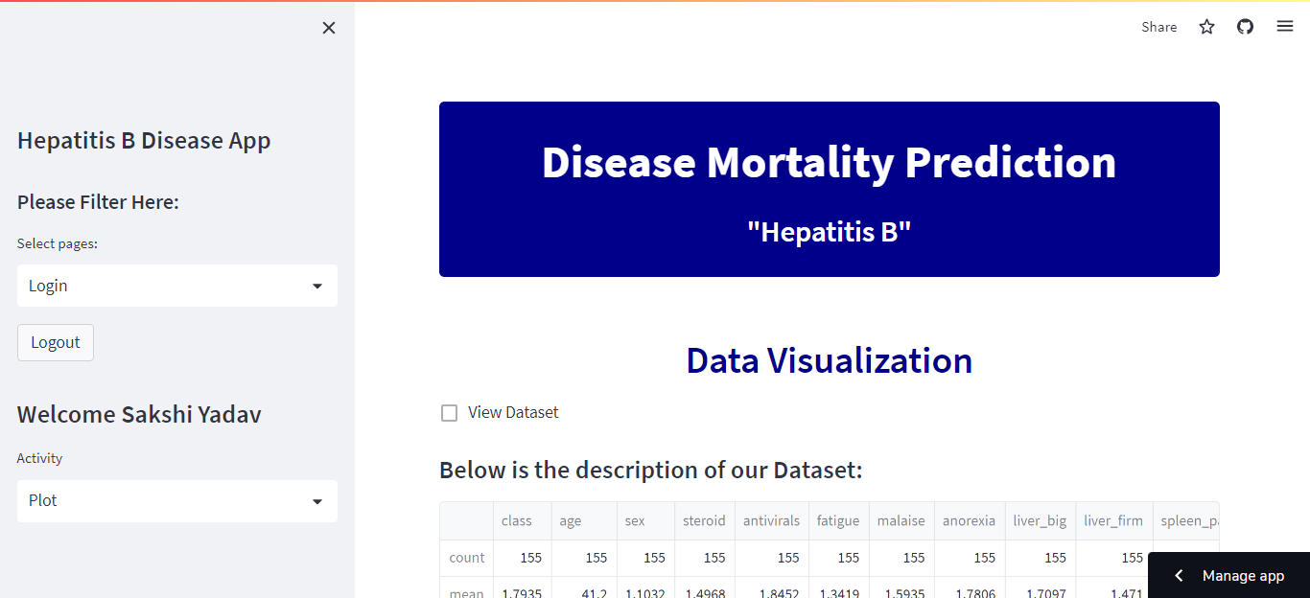
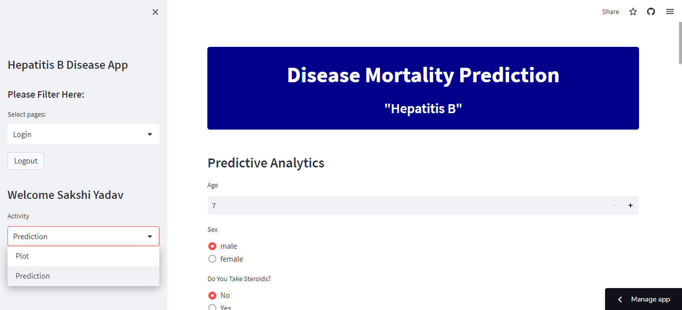
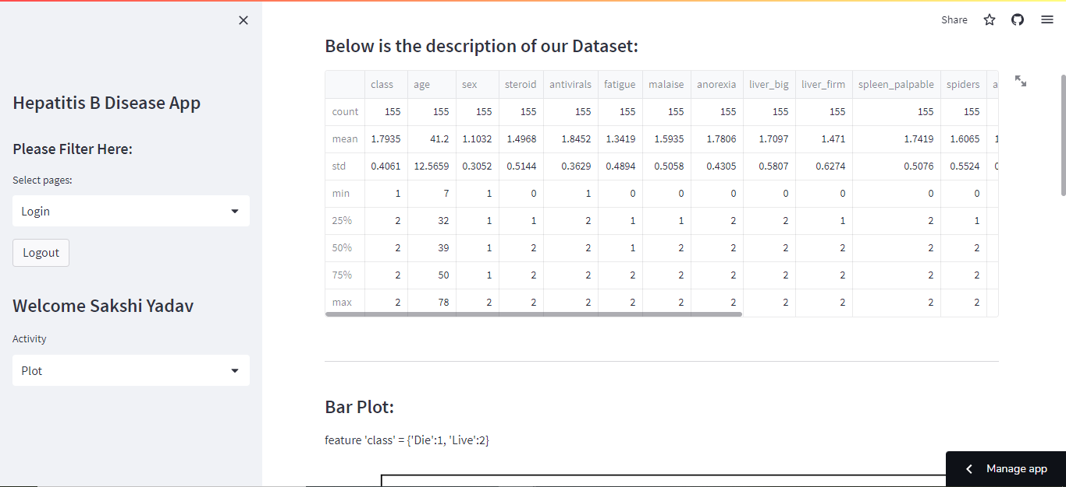
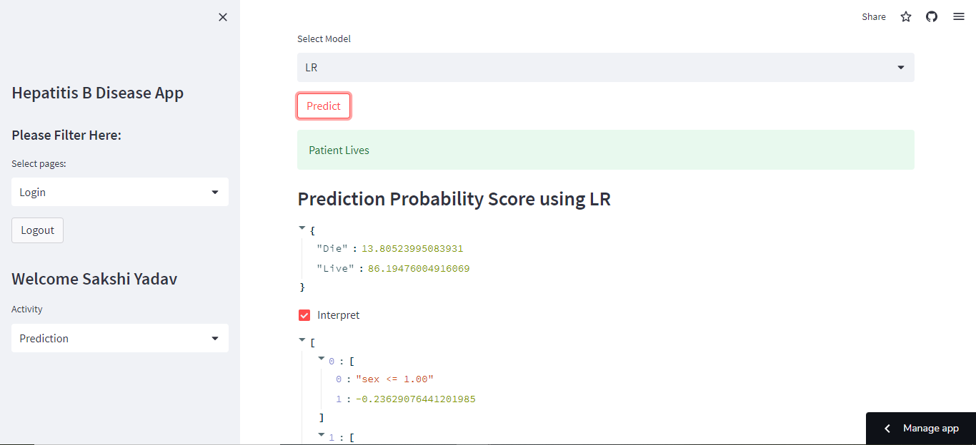
Output images

Slide 11



Conclusion:
Most of the data points were in objects.
Two of them were of float type.
There were more males than females in our dataset.
Highest prevalence of Hepatitis is from 30-40 followed by 40-50.
The least are the individuals under 10, and elderly above 70.
All the methods gave us almost the same features to use i.e. all the features are important.

Slide 12

thankyou
nilsson@example.com
678-555-0100

